Slide 1
Digital Experiences
for
Insurance Domain
OPPORTUNITIES TO INNOVATE AND ENERGIZE THE DIGITAL ROADMAP

Slide 2
Agenda
1
VirtusaPolaris’ Digital Portfolio
2
Adobe Partnership
3
Insurance – Reference Solution
4
Recommended Adobe Products
5
Case Studies

Slide 3

VirtusaPolaris’ Digital portfolio

Slide 4
VirtusaPolaris helps clients implement strategies for innovative, enterprise-wide digital transformation
Digital practice
2500
Digital experts for consulting, design, development & QA
80%
YoY growth supported by digital transformation programs
200+
Projects executed globally
15Years
Delivering digital programs to enterprises
Partners
with Adobe, Oracle, IBM, SAP, Microsoft, Kony, Jive, Pega (Antenna)

Slide 5
Digital Transformation Services
Digital practice
Digital strategy
Experience design
Design exploration
Technology selection
Front-end engineering
Omni-channel + web
Digital marketing
Social integration
Ecommerce
Gamification
STRATEGY + DESIGN
CUSTOMER EXPERIENCE
Mobile + wearables
Internet of things
Mobile payments
Mobile QA + automation
Mobile deployment
Big data + analytics
Data strategy + consulting
Master data management
Natural language processing
Business intelligence
MOBILE + IoT
DATA + ANALYTICS
Cloud assessment + strategy
Cloud development
Cloud migration
Cloud integration + security
CLOUD SERVICES

Slide 6
We categorize digital transformation programs into 3 key areas
Digital Transformation
Customer insights
Digital business models
- Analytics-based segmentation
- Socially-informed knowledge
- Customer 360
- Digital products
- As a Service offerings
- Connected products
Customer centricity
Innovation velocity
- Omni-channel experience
- Cross-channel coherences
- Personalization
- Product/service differentiation
- Transitioning physical to digital
- Idea generation and execution
Customer Experience
Business
Model
Revenue generation
Business agility
-Digitally-enhanced selling
-Predictive marketing
-Streamlined customer processes
- Adaptability to change
- Globalization
- Competitive threats
Operational Excellence
Process automation
Workplace efficiency
System agility and scalability
- Operational transparency
- Robotic Process Automation
- Risk and compliance
- Productivity and collaboration
- Mobile worker field enablement
- Employee engagement
- Platform efficiencies
- Cloud and micro-services adoption
- Data-driven decision-making

Slide 7
VirtusaPolaris’s end-to-end Customer Experience Management offerings support today’s CXOs to drive digital transformation and business growth
Customer Experience Capabilities
Web Strategy & Transformation
UX and Visual Design
Mobile Web
Digital Marketing & Loyalty
(Benchmarking, TCO/ROI)
(User Research, User Journeys, Usability)
(Mobile Apps, Mobile Payements, Analytics, etc.)
(A/B & MVT Testing, Targeting, Audience Management, Analytics, Personalization)
Predictive Analytics and NBA
Social and Gamification
Omni Channel & WEM
Ecommerce
(Next Best Action) (Advance personalization & Recommendations)
(Ratings, Reviews, Comments, Communities)
(Online Shopping, Ordering, Payment Gateways, Fulfillment)
(Portals, Content Management, etc.)

Slide 8








Digital practice
VirtusaPolaris Digital Ecosystem

Slide 9
Adobe Partnership

Slide 10

Adobe Partnership
CEM Practice at VirtusaPolaris
Leadership
Innovation
Integration
Environment
Innovation Partner
of the Year 2015
Web, Mobile,
IoT, Cloud
Multi-Domain
Expertise
Established Expertise
Adobe Innovation Partner of the Year 2015
200+ skilled consultants dedicated to CEM
Successful implementations for Fortune 2000 clients
CEM practice
End-to-End Solution
Agile development with continuous delivery
Infrastructure integration (In-premise, as well as Cloud)
Managed services for SLA based Application support
Virtusa Launchpad & Accelerators
Pre-built AEM components for rapid development
Domain-specific ‘ready-to-use’ AEM solutions
Working AEM site in as low as 2 months
CEM practice delivers speed, unmatched value and uncompromised quality for today’s market

Slide 11
AEM Launchpad
50+ components to speed up website launch
Client Additional Custom Components & Styles
More than 50 Custom Components
Social Login
Facebook Feed
Social Follow
Twitter Feed
MSM
Mail Configuration
Resource Resolver
Minify & GZip
Tagging Taxonomy
Scaffolding
i18n
SiteCatalyst
3-Break Point Responsive Design Using Twitter Bootstrap
Pre-built AEM App
Maven Build & Deploy
Java Bundle with JUnit
App & Clientlib Structure
Content Migration Engine (XML to AEM)
Comprehensive Author Guide
Complete Developer Guide
Vertical Demo Sites
Adobe AEM Platform [All versions]
2-Col Grid
Advanced Search
Article
Breadcrumb
Carousel
Category
Chart
Comments
Composer
Contact Us
Event Agenda
Event Info
Event List
Event Preview
Facebook Feed
Featured
Free-HTML
Free-JavaScript
Gallery
Geolocation Map
Header
Hello World Base
Hero
iFrame
Image
Latest
Long Article
Map
Most Commented
Most Viewed
Navigation
News
Responsive Image
RTE
Search
Section Navigation
Short Article
Simple Search
Site Navigation
Social Follow
Social Login
Subheader
Table
Tag Cloud
Twitter Feed
Video
Weather
YouTube

Slide 12
Virtusa Polaris advantage
Virtusa Polaris Advantage
Team Readiness
CEM Practice
Over 200 AEM Consultants providing the largest AEM practice outside of Adobe
Strong experience with over 50 major global level implementations
Strong AEM and Cloud practices
Ability to mobilize the required team quickly
Strong Partnerships
Award Winning Partner of Adobe
Leading Amazon Global APN Channel Partner and global reseller of AWS
AEM
Launchpad
A robust framework to reduce time to market and total cost of ownership
Customizable for project specific components and migration toolkits

Slide 13
Digital program playbook
Our Digital Delivery Playbook leverages implementation best practices to mitigate project risk
Discovery/Planning
QA/Transition
Stakeholder Discovery – Governance Plan, Digital Marketing Plan,
Creative Brief + Content Strategy
Customer research
Content strategy brief by audience and site taxonomy
QA Test Plan
AEM Basic Knowledge Base/ Quick Reference Guides
Performance Test Plans
Experience Development
Planning/Measurement
User Experience Designs
Ready to use Components
Build Plan/Scripts
Security Plan/Best Practices
Analytics – Industry standard KPIs, Benchmarks, Integration Plans
Deployment Checklists/Run-books

Slide 14
Launchpad
Faster is better: Our domain accelerators enable our clients to bring experiences to their audiences faster
Omni-channel Product Application Framework
Improve user engagement and reduce drop-offs. Integrated with analytics and campaign to follow up with customers experience and partial applications
Manage, Monitor, Monetize
Requirement Phase
Mobile Apps Foundation Framework
Rapidly create mobile apps and deliver an engaging experience. Push content and notifications with no development.
Infrastructure Setup Phase
Rapidly create mobile apps and deliver an engaging experience. Push content and notifications with no development.
Complexity
Custom Development Phase
Site Launch
Duration
Typical Development
BFS LaunchPad
Authenticated sites
Highly Personalized Landing & Product pages
Build authenticated user portals and presents them with personalized experience, user data, and targeted offers
Compliant with Accessibility, SEO
Plan, design, launch, and optimize personalized experience for existing as well as potential customers
Compliant with accessibility guidelines under section 508, WCAG, and SEO standards
Integrates with Adobe Target, Adobe Analytics, Adobe Campaign and Adobe Mobile

Slide 15
Business benefits delivered
Business benefits
Faster time to market
Website is launched in a short span of 6 – 8 weeks.
Lowered cost of ownership
Enhancements only require an incremental effort due to the underlying scalable architecture and design.
Enhanced user experience
LaunchPad based websites have a consistent look and feel across devices: PC, mobile, tablet.
Reduced maintenance costs
With a LaunchPad implementation, customers can get the best of Virtusa’s proven solutions as the foundation for a new site.
Improved brand equity
Plug and Play components have been designed keeping in mind the important parameters of brand recall and digital presence

Slide 16
Insurance – Reference Solution

Slide 17



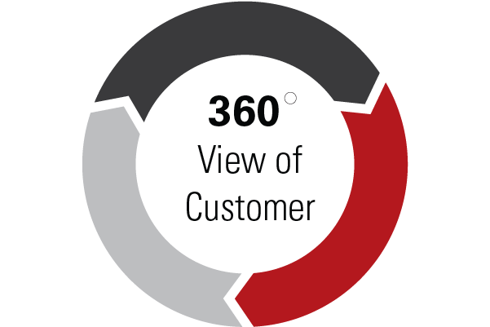








Key components of the solution
Solution - Overview
Our solution focuses on building key accelerator components targeted for significantly enhancing Insurance Company’s overall value proposition
Experience
Customer Persona
Partnership
Indifferent > Satisfied > Loyal > Advocate
Discover > Shop > Buy > Share
24
Mobile
Social
Call center/ Helpdesk
Self Service
Retail Outlet
Online
Touchpoint Transformation
Omni-channel Orchestration
Relationship
Employees
Identity Management
Product
Catalogue
Product
Modeller
Credit Rating
Next Best Action
(Guided Agent)
Customer Hub
(360 degree view)
Campaigns Management
Loyalty Management
Content Management
Bank Account Validation
Sales Executive appointment calendar
Point Services
Mobile Native Applications
Document Letter Generator
Document Management
Integration layer
Engineers visit appointment calendar
SMS/Email Gateway
(inbound /out Bound)
Equipment delivery agency appointment calendar
Orchestration Engine
Workflow
BSS and OSS systems (e.g. Fulfilment, Billing, Service Management etc.)

Slide 18
Key components
Solution - Key components
PRODUCT CATALOGUE | CUSTOMER HUB (360 DEGREE VIEW) | ‘NEXT BEST ACTION’ (GUIDED SELLING AGENT) | CAMPAIGN MANAGEMENT | LOYALTY MANAGEMENT
Product Configuration GUI Interface Product Distribution Pricing Configuration Discount Configuration Bundling Rule Configuration Product Rules Business Rules Discounting Rules Product Independent Rules Eligibility Rules Orchestration Rules ? 4 Level Hierarchy Support | Customer Data Model 360 Degree Presentation View Order, Product, Usage, Complaints, Incidents, Bill etc Customer Satisfaction Index Integration with CRM, Inventory, Billing, Service Assurance | Product / Service Recommendation Browsing History Current Product & services Usages Product Compatibility Seamless Integration across Channels Integration with Loyalty Management Integration with Customer 360 Integration with Order Management | Campaign Configuration Product Discount and Offer Configuration Campaign Objective Integration with Data Warehouse Integration with Order Management Seamless Integration across Channels ( incl. Email, IVR, SMS) Campaign Tracking | Loyalty Configuration Tenure Age Location ARPU Usage Customer Segment ( Gold, Silver, Bronze) Integration with Data Warehouse Integration with Customer 360 Integration with Order Management
1
2
3
4
5
CONTENT MANAGEMENT | SELF SERVICE (MOBILE /WEB) | FRONT END CHANNEL | Document Generator | Document Management
Multi-site management Digital Asset management Blogs / Social communities Adaptive Forms Mobile Apps | Biometric Authentication Speech Recognition Top Up Balance enquiry Authentication Identity Management - Scan Self Service Top Up SIM Activate Location Base Services Integration with Mobile Wallet | Pre-sale Pages Product Pages Shopping Cart Submit Order Order Decomposition & Management Web Analytics | Customisable templates Output to multiple formats (e.g. PDF, DOCX, HTML etc.) Integration with printer Creation on demand or via automated schedule | Metadata Integration Capture Validation Storage Retrieval Distribution Security Workflow Collaboration Publishing Indexing
6
7
8
9
10

Slide 19
Recommended Adobe products for Insurance Solution

Slide 20

Adobe Target for Accelerated Conversions & Sales
Item Boosting
Boost particular items based on attributes like Brand, maturity-life-of-policy, monthly return, premium value, etc.
Import recommendations into email applications to increase relevancy of the email campaigns.
Automated Recommendations
Machine-learning driven recommendations.
No API or Catalog integration is required. No IT support required.
Engage, Cross-sell, Upsell
Recommendations for every context –
Home page, Product pages, Checkout, e-mail.
“Always-on” experience ensured by backup recommendations.
Adobe Target
Segmentation & Rules-based targeting
Personalize offer for customer of a specific competitor.
Visitor segmentation based on external CRM data.
Proximity / Location based targeting for mobile apps.
Monitor, test, and optimize
Test & compare variations in the content.
Monitor real-time performance.
Define and manage KPIs for each variant.

Slide 21

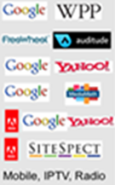
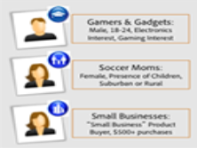

Adobe Audience Manager for Audience Data Management
Generic Users
Reliable Profiles
Multi-channel Conversations
Display Ad Servers
Video Ad Servers
Exchanges
Demand Platforms
Dynamic Creative
Dynamic Content
Emerging Channels
Graduates
Soccer Moms
Small Business
Collect Audience Data
1st party
Online &offline
Structured & Unstructured
2nd party
Strategic Partners
Advertisers
3rd party
Data Sellers
Data Exchanges
Organize, Segment & Score
Organize
Custom Taxonomy
Maximum flexibility
Segment
Real-time
All sources of data
Score
Data Quality
Rate of deterioration
Distribute and Protect
Ubiquity
All Digital channels
All Online technologies
DRM
Data sharing rules
Data loss prevention
Privacy
Transparency
Control

Slide 22

Adobe Analytics for Actionable Insights
360-degree customer analysis
Build customer profiles with online and offline information
Customer Journey Optimization
Analyze all points of interaction with customers to improve cross-sell / upsell opportunities
Propensity Scoring
Predict which customers are the most likely to convert, so that they can be targeted efficiently.
Adobe Analytics
Live Stream
See what’s happening right now with your site visitors through real-time event visualization.
Contribution analysis
Intelligently identify potential causes for anomalies in trended data.

Slide 23




Adobe Campaign for personalized cross-channel campaigns
Contextual email marketing
Deliver uniquely relevant email experiences, coordinated with other channels — including offline.
Real-time interaction management
Use a centralized catalog to select and present personalized, relevant offers in an instant.
Cross-channel campaign orchestration
Easily manage every aspect of marketing campaigns, and then watch results in real time.
Adobe Campaign

Slide 24

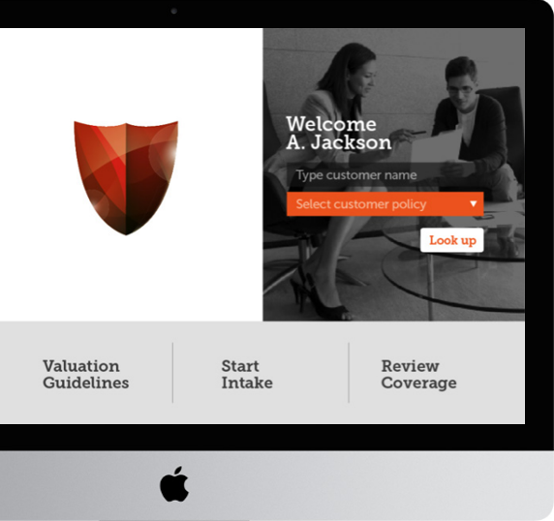
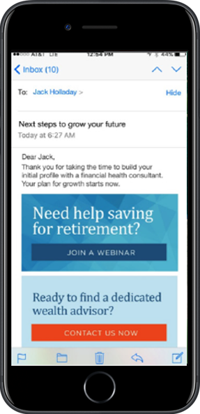
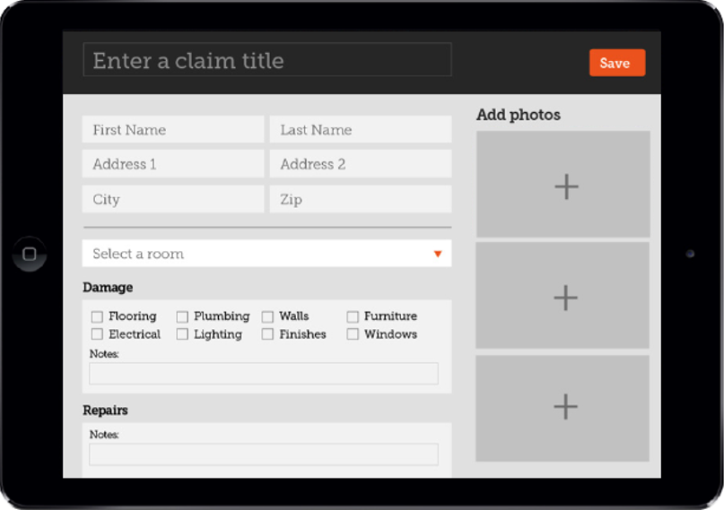
Adobe Experience Manager for Easy Content Management
Web Content
Consistent and relevant web experience on every device.
Forms
Make the form and document processes paperless, efficient and automated with the ‘anywhere, any-device’ adaptive forms.
Mobile Apps
Deliver beautiful Mobile Apps with maximum ROI
Communities Include forums, groups, learning resources & other social features.
Assets
Manage images, videos, and other assets across all digital channels.
Commerce Immersive and personalized shopping experiences that incorporate video, social and other dynamic media.
Marketing campaign management Organize, launch, and optimize campaigns across digital channels.
Multisite management Manage multiple web and mobile sites centrally, and automate translation workflows.

Slide 25
Case Studies

Slide 26
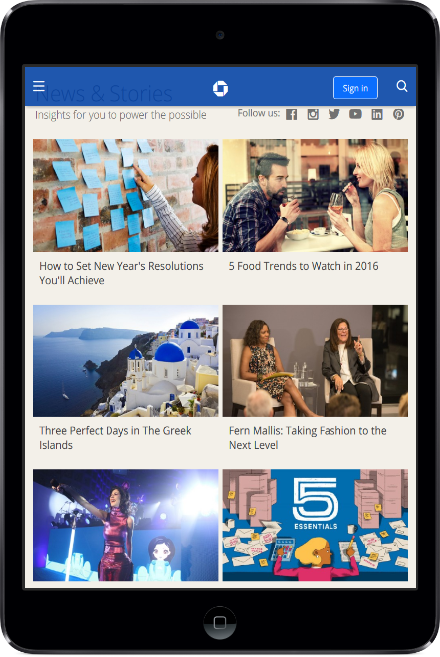
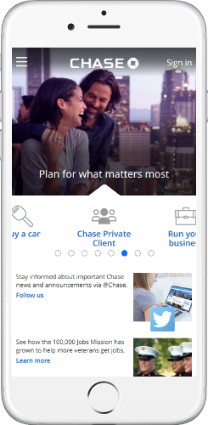
Virtusa helped increase revenue through website transformation strategies by increasing customer traffic & enriching Omni Channel experience to large US bank
CEM Success Stories
Key Objectives
Key Capabilities
Provide consistent omni channel experience to customers
Provide personalized content and targeted offers to Chase's prospects and customers
Deliver a highly intuitive user experience with High Definition (HD) adaptive media content
Increased revenue by displaying Ads
Responsive page design
Adaptive media
Device Agnostic
Enhanced SEO
Personalization
Quick content and layout changes
Social Media Integration
Optimized Search

Slide 27
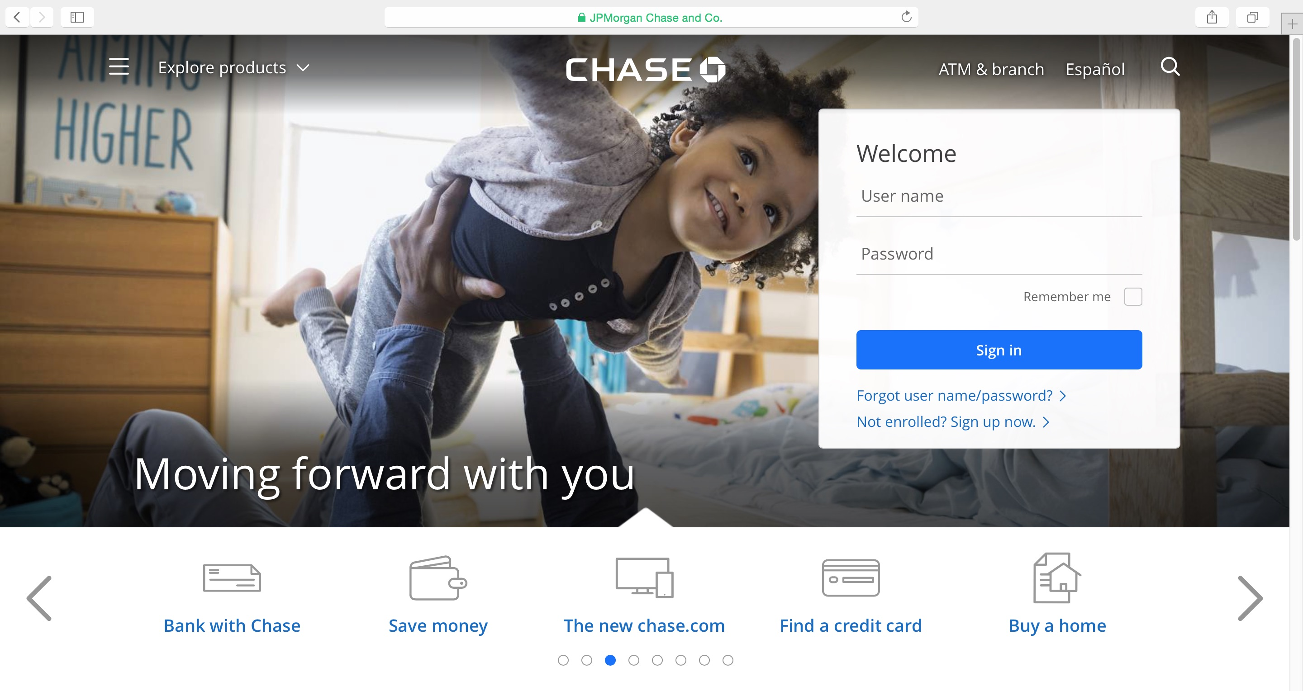
CEM Success Stories
Business Outcomes
Improved accessibility by providing Omni-channel support
Increase Revenue through targeted personalized content
Reduce maintenance cost by decommission customs applications for mobile devices
Enhanced user experience through Rich Design on HTML5 & Responsive and intuitive UI
Faster time to market through Virtusa’s platforming approach thereby increase new customers by 22%

Slide 28
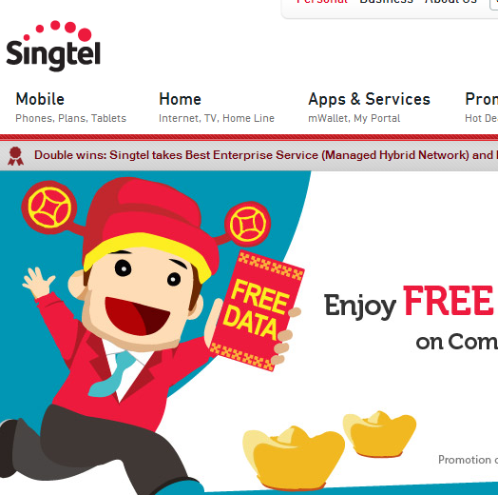
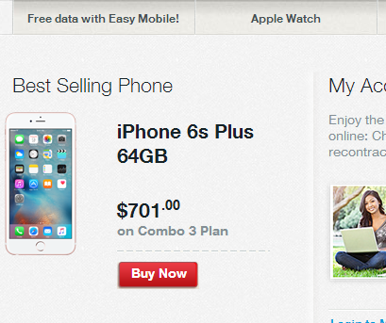
At Large Telecom Customer, Virtusa helped develop the next generation Omni-channel commerce platform hosted on AWS
CEM Success Stories
Key Objectives
Key Capabilities
Reduce High costs of maintenance & support for multiple sites, technologies, different back-end systems
Improve engagement on online channels
Improve turn-around times for searches - leading to lower customer engagement
Increase ROI on marketing and promotions.
Implemented unified portal with centralized management of all content.
Multi-touch points enablement with a consistent UI, having ease of usability and streamlined flow.
Ability to create Omni channel and multi channel campaigns for marketing.
Personalized product and service with reviews/ ratings
Campaign and promotion management, integrated with Adobe Marketing products

Slide 29






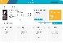


At Large Telecom Customer, Virtusa helped develop the next generation Omni-channel commerce platform hosted on AWS
CEM Success Stories
Business Outcomes
Unified Platform. Single Source of truth. Consistent experience across channels
Personalized Interface for every customer
Competitive Advantage by enabling Marketers to publish and update product catalogs on demand
Higher adoption of online channels with increase in sales driven by higher traffic on online channels
Faster searches leading to good customer experience in turn to increased sales.
Reduced spend on Blanket Promotions and offers.
CHANNEL APP
RESEARCH
BUY
ENGAGE
SHARE
CUSTOMER
EXPERIENCE
Digital Care & Mobile Commerce Apps
Adobe Experience Manager Sites
OMNI-CHANNEL FRAMEWORK
EXP FRAMEWORK
WIDGET LIBRARIES
OMNI-CHANNEL RUNTIME
BILLING CARE
SUPPORT
REST services
Adobe Marketing Cloud
Adobe Experience
Manager (W-CMS)
ACCOUNT MANAGEMENT
ORDERING & COMMERCE
SINGLE SOURCE OF TRUTH
Back-end core functionality

Slide 30
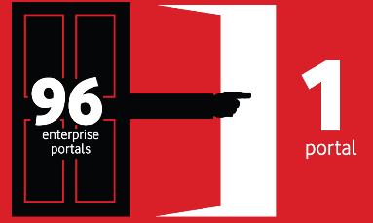
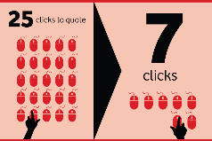
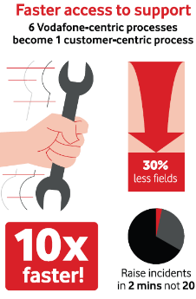
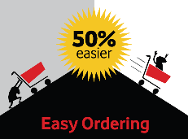
At Vodafone, Virtusa helped rationalize their technology, develop a unified customer experience and implement automation for their OnePortal initiative
CEM I Success Stories
Key Objectives
Key Capabilities
Improve and unify customer experience
Rationalize disparate portal technologies
Reduce cycle time through automation
Global products
Quote to Order
Billing
Analytic, reporting & dashboards
Online self care
Online assistance
Mobile
Search
Personalization
Monitoring
Portal security

Slide 31

Vodafone one portal
CEM I Success Stories
Business Outcomes
Delivered a unified & consistence customer experience while driving down cost and time to market
Consolidated multiple portals & processes into one
Enhanced Self Service capabilities while making the user journey more intuitive.
Faster and easy to enhance due to scalable architecture
SINGLE SIGN-ON (SSO) & CENTRAL IDENTITY MANAGEMENT
Identity Management
Enterprise Portal
Policy Configurations
Quotes
Ethernet Order Capture and Tracking
Wholesale Order Capture
and Tracking
Online Self Service
Assure
User Administration
Product Brochures
(Managed Content)
Personalisation
Login and Profile Management
Notifications
My Contacts
Virtualised User Store
User Store
Caching
Drag & Drop
Page Creation
MIS & Perf Reporting
Web
Analytics
Portal & User Admin
Security & Policy
J2EE Application Server
MyVCO
TOP
Enterprise.vodafone.com (Post Phase 1)
PHP Portal
(Closure)
GCF Portal (Closure)
IBM Portal
(Closed)
B2B Portal Business Logic (SOAP Web Services)
Single Sign ON
WebMethods Integration Services
Minuco
SOX
Clarify
Remedy
TOP
Mozart
TOP
Mozart
Application Data (Oracle 11g DB)
Analytics Data Store
LDAP User & Group Store
Edge
Portal Scope
Scope for External Systems

Slide 32

Thank You
Chandra Shekhar
shekharc@virtusapolaris.com
www.virtusapolaris-digital.com
Image rights: www.cadeninternetmarketing.com
2016 Virtusa Corporation. All rights reserved. Virtusa and all other related logos are either registered trademarks or trademarks of Virtusa Corporation in the United States, the European Union, and/or India. All other company and service names are the property of their respective holders and may be registered trademarks or trademarks in the United States and/or other countries.

